Slide 1
Living the dream
Real world DevOps with GitHub & Azure

Slide 2






Richard Fennell
Chief Technology Officer (CTO)
MVP (Developer Technologies)
@RichardFennell

Slide 3
What is DevOps

Slide 4

What is DevOps?
“It’s a job title”
“It’s automation”
“It’s Development and Operations collaboration”
“It means faster and smaller releases”
Notes:
So, what is DevOps exactly?
DevOps is a term for a group of concepts that, while not all new, have catalyzed into a movement and are rapidly spreading throughout the technical community.
Like any new and popular term, people have different and sometimes contradictory perceptions of what it is.
One thing is sure: it’s not a product that you buy and install to fix everything that is wrong or broken with software development.
However, tooling is an integral part of any DevOps discussion because tools help you execute on your DevOps strategy.
Today we’ll talk about how the application lifecycle is changing as it extends into IT operations and will take a closer look at our next wave of ALM and DevOps investments.

Slide 5

DevOps is the union of people, process, and products to enable continuous delivery of value to your end users.
Donovan Brown
Cloud Advocate Manager of the Methods & Practices
Microsoft
Notes:
All software development is about communication
There is no magic bullet tool
All 3 areas must be addressed

Slide 6


46x Deployment
Frequency
2,555x Faster Lead
Time For Changes
Faster
Time to Market
DevOps
$
Increased
Revenue
7x Lower Change
Failure Rate
2,604x Faster Mean
Time to Recover
Source: 2018 Accelerate: State of DevOps: Strategies for a New Economy." N. Forsgren, J. Humble, G. Kim. DevOps Research and Assessment (DORA)
Notes:
High Performance DevOps Companies Achieve…

Slide 7
Five Pillars of DevOps
Production first mindset
Reduce organisational silos
Left Shift Quality
Measure everything
Accept Failure as normal

Slide 8
Build& Test
Deploy
Continuous Delivery
Develop
Operate
Plan & Track
Monitor & Learn

Slide 9






DevOps is key to digital transformation
40
%
… of implementations end up getting reworked because they don’t meet the users’ original requirements
IT drives business
success!
High IT performance correlates with strong business performance, helps boost productivity, market share and profit
Outperforming teams are
collaborate
54
%
more likely to
extensively
41
%
… of development budgets for software, IT staff and external professional services will be consumed by poor requirements
with their
Collaboration blockers
counterparts
26.7% No executive support
56.7% Cultural inhibitors
43.3% Fragmented processes
Developers
IT Ops
%
Business
70
o
f
CIOs
Would increase risk
1 in
6
It takes on average 200 minutes to diagnose and repair a production issue
IT decision makers is still unfamiliar with the term DevOps
to reduce IT costs
and accelerate business agility
3/4
of teams
DevOps was being initiated by more development teams than IT Ops teams by about a 40% to 33% margin
The average hourly cost of infrastructure failure is $100,000 per hour
Responding to ongoing needs for efficiency and growth
have adopted
Agile methodologies
dual goals
Always keeping all systems safe and secure

Slide 10
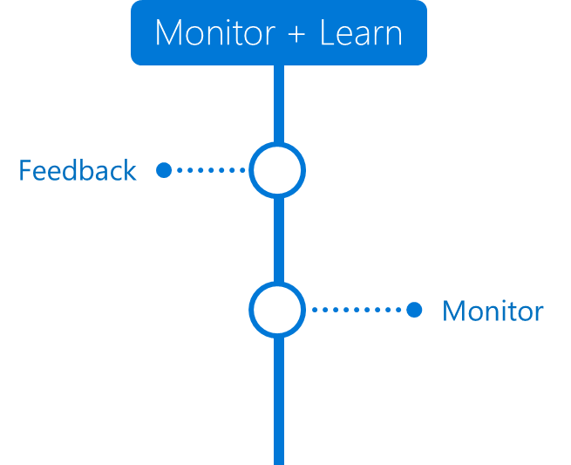



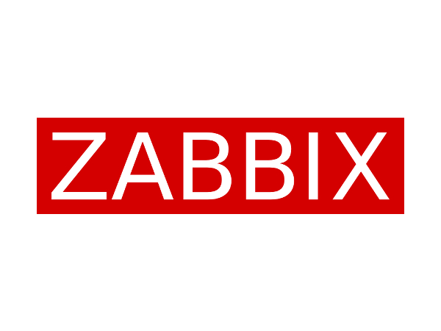
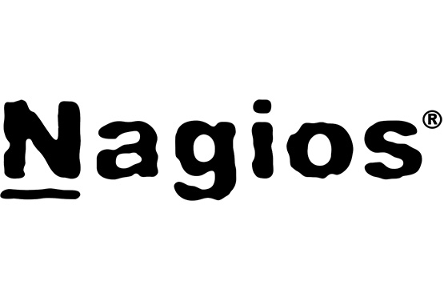
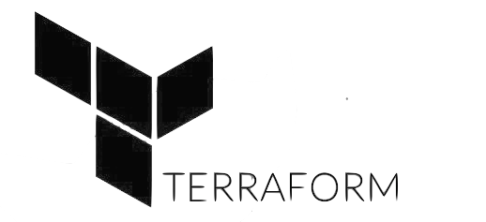
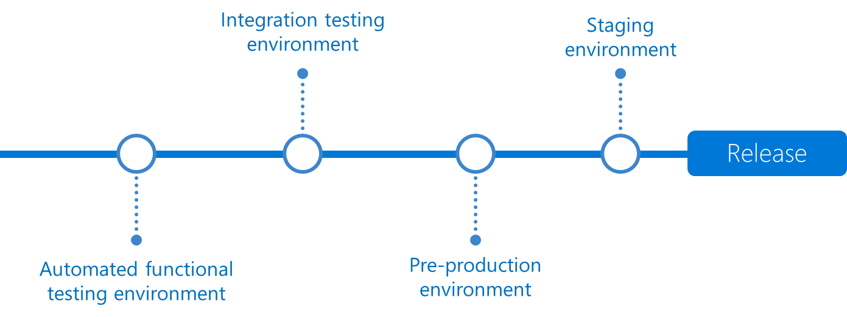
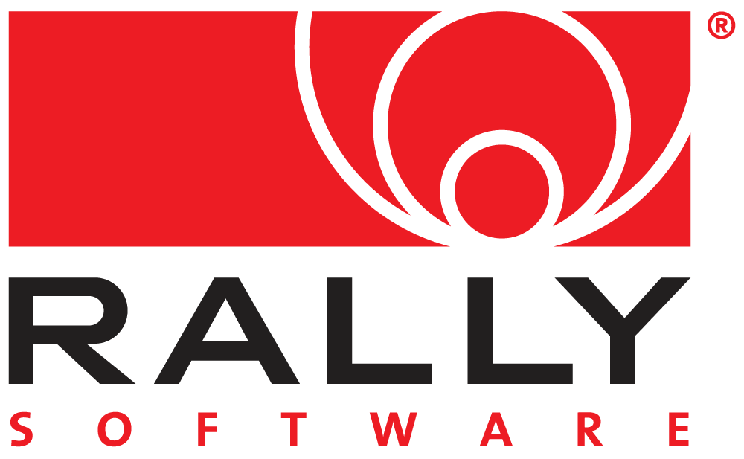


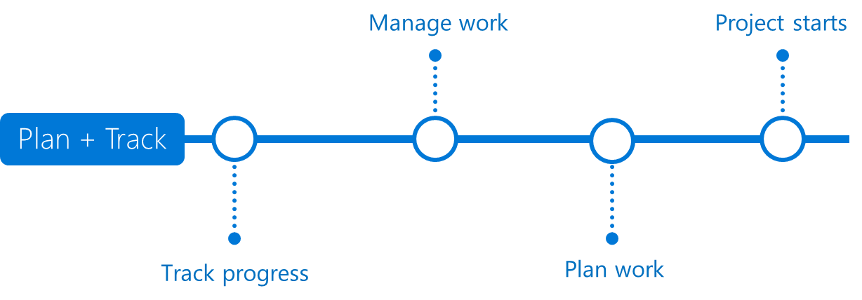


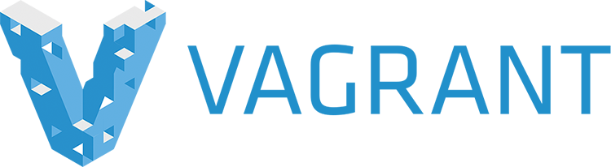


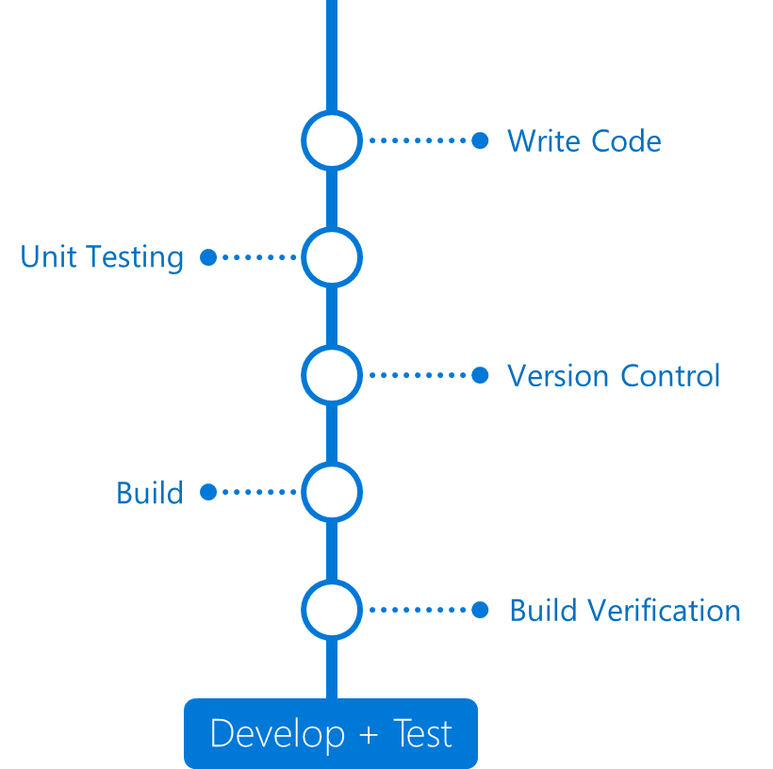



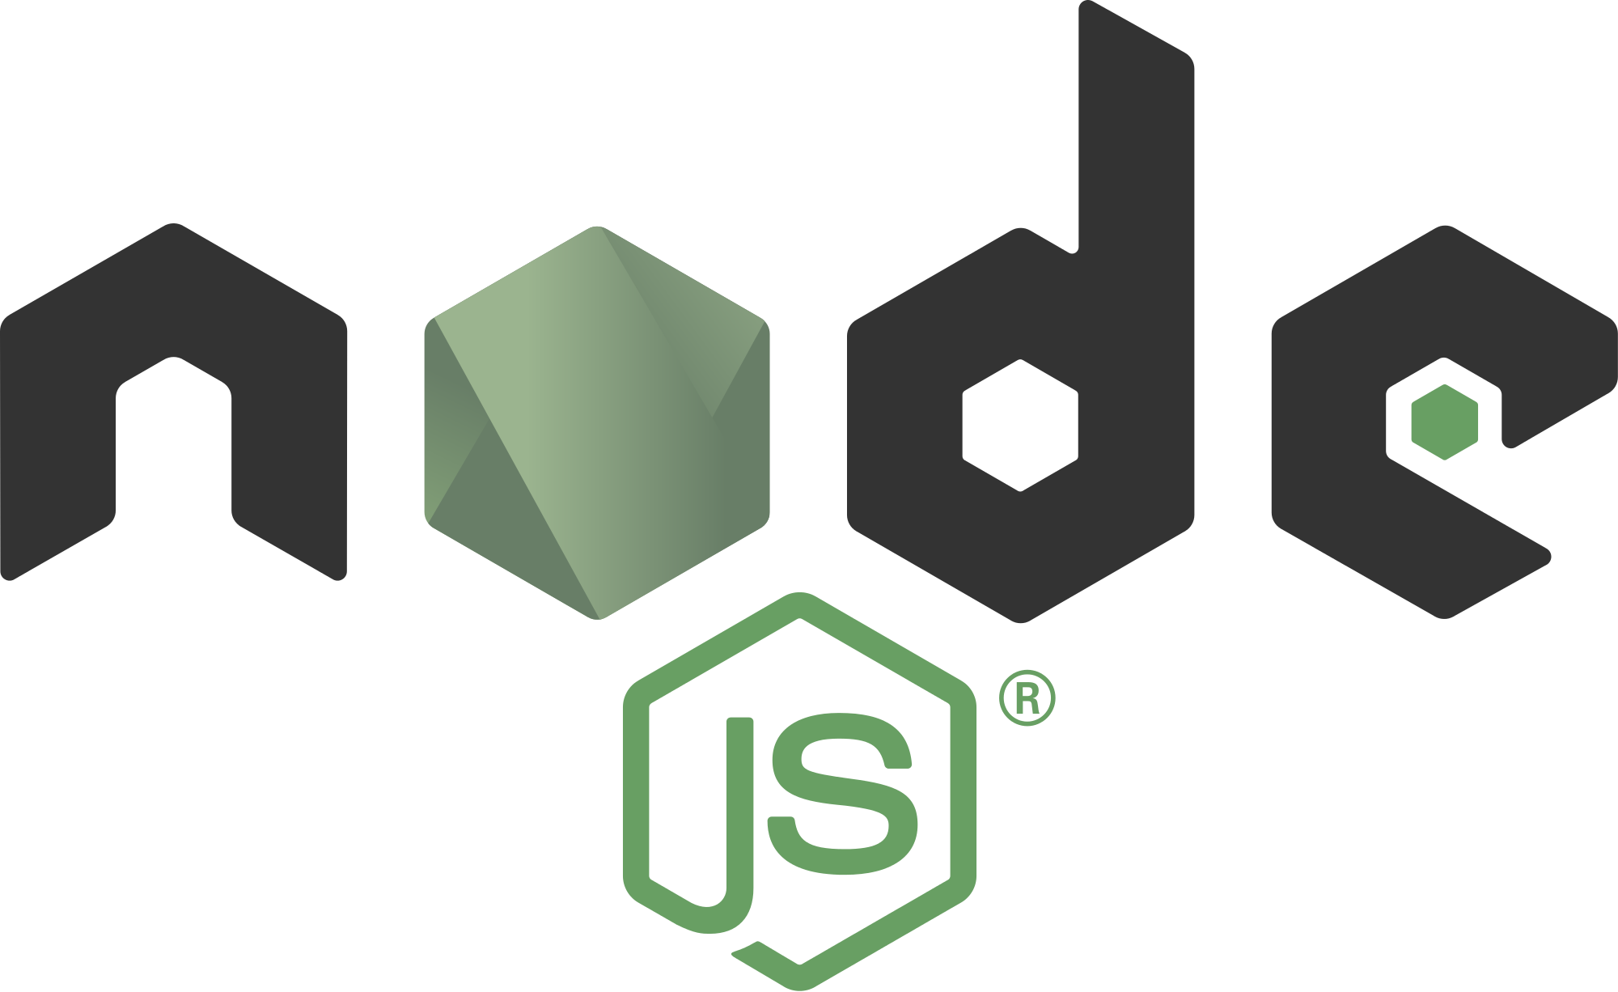



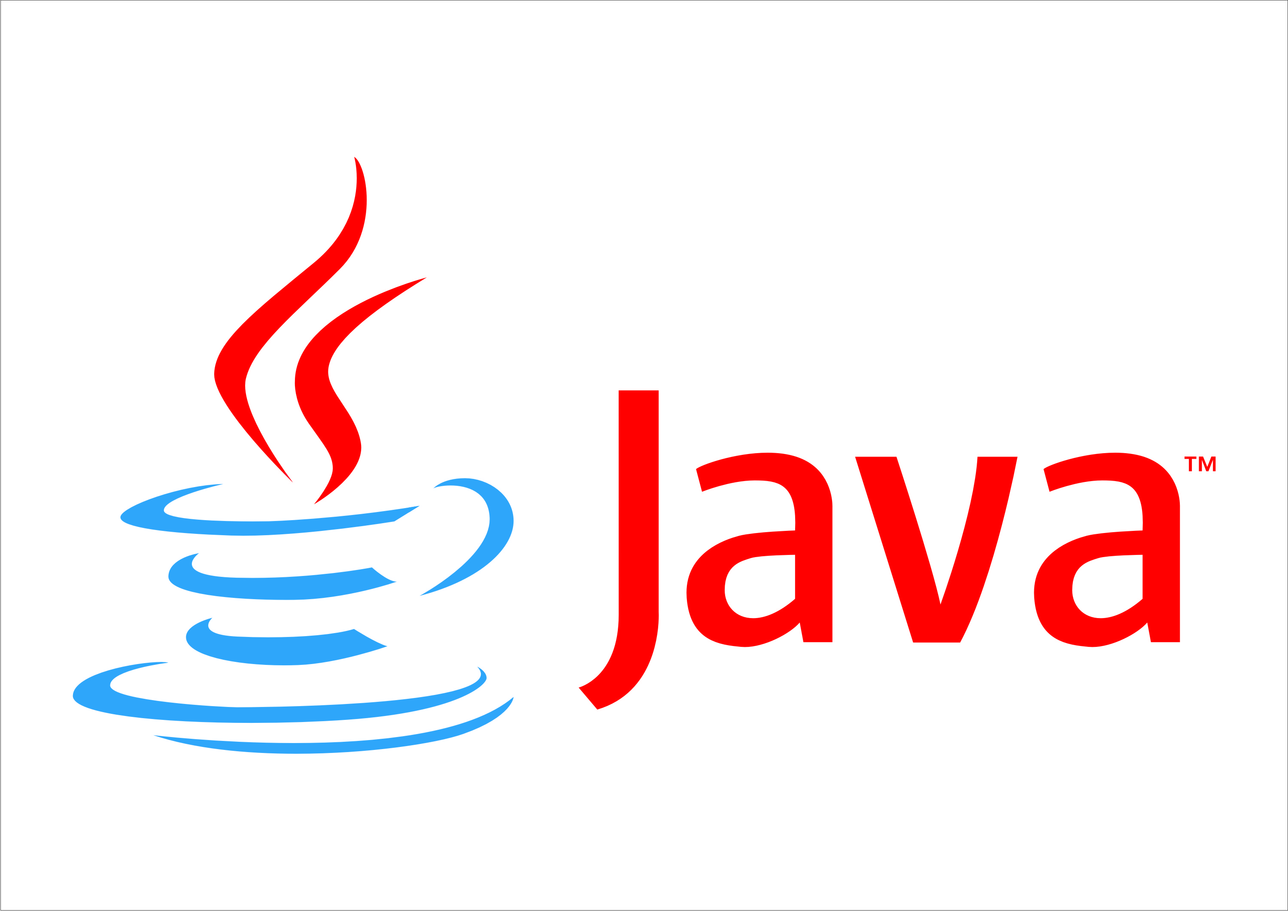






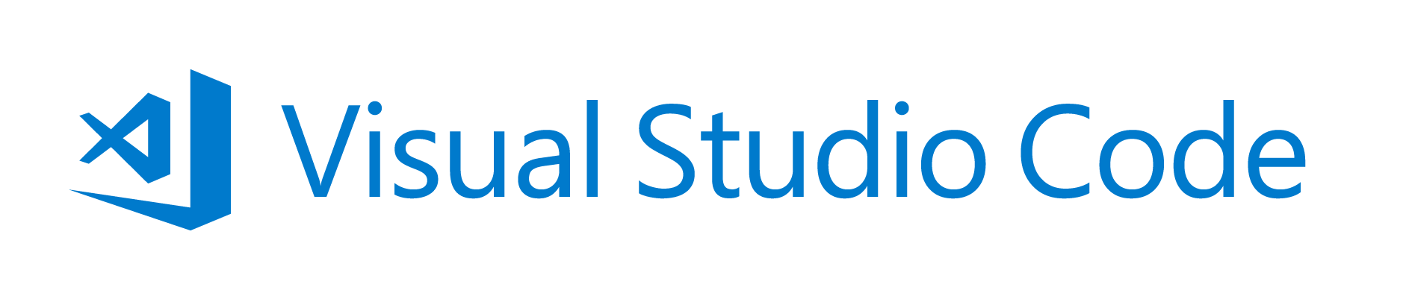




Application Insights
Visual Studio

Slide 11




Walking through the process
Develop
Build
Deploy to QA
Deploy to Lab

Slide 12
Demo
A walk through of Continuous Delivery

Slide 13
And in summary
Notes:
DevOps is not a product
All working together
Nice summary is MS

Slide 14
Definition of Done Live in production, collecting telemetry, supporting or diminishing the starting hypothesis.
Azure DevOps Product Team

Slide 15

Question?

Slide 16






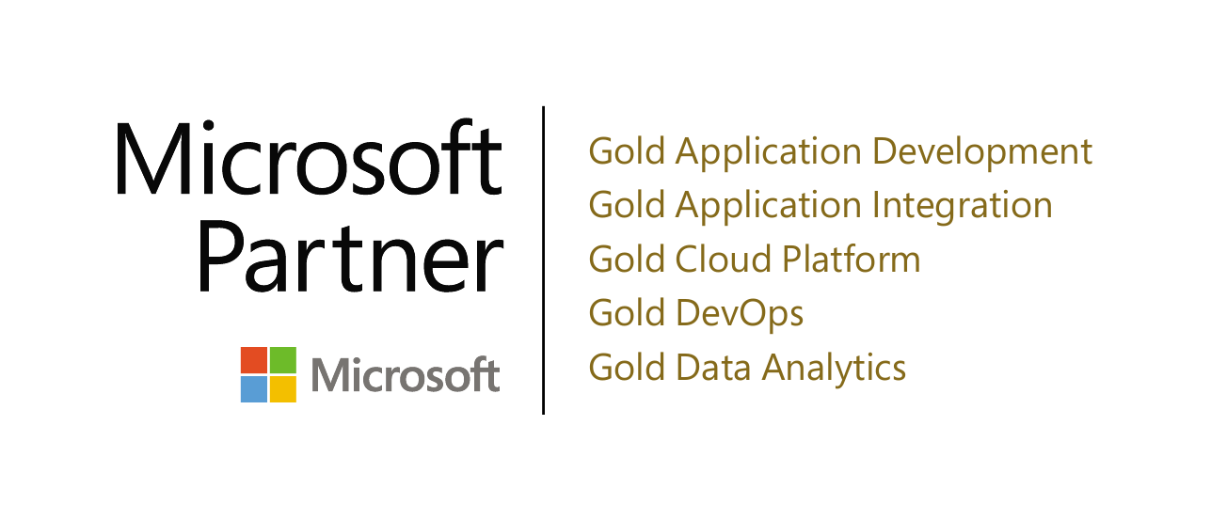

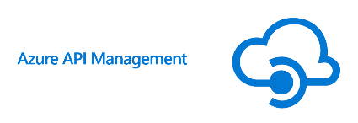





Azure Integration Services

Slide 17





blogs.blackmarble.co.uk
+44 (0)1274 300175
@blackmarble
Black Marble Ltd.
Black Marble

